Slide 1
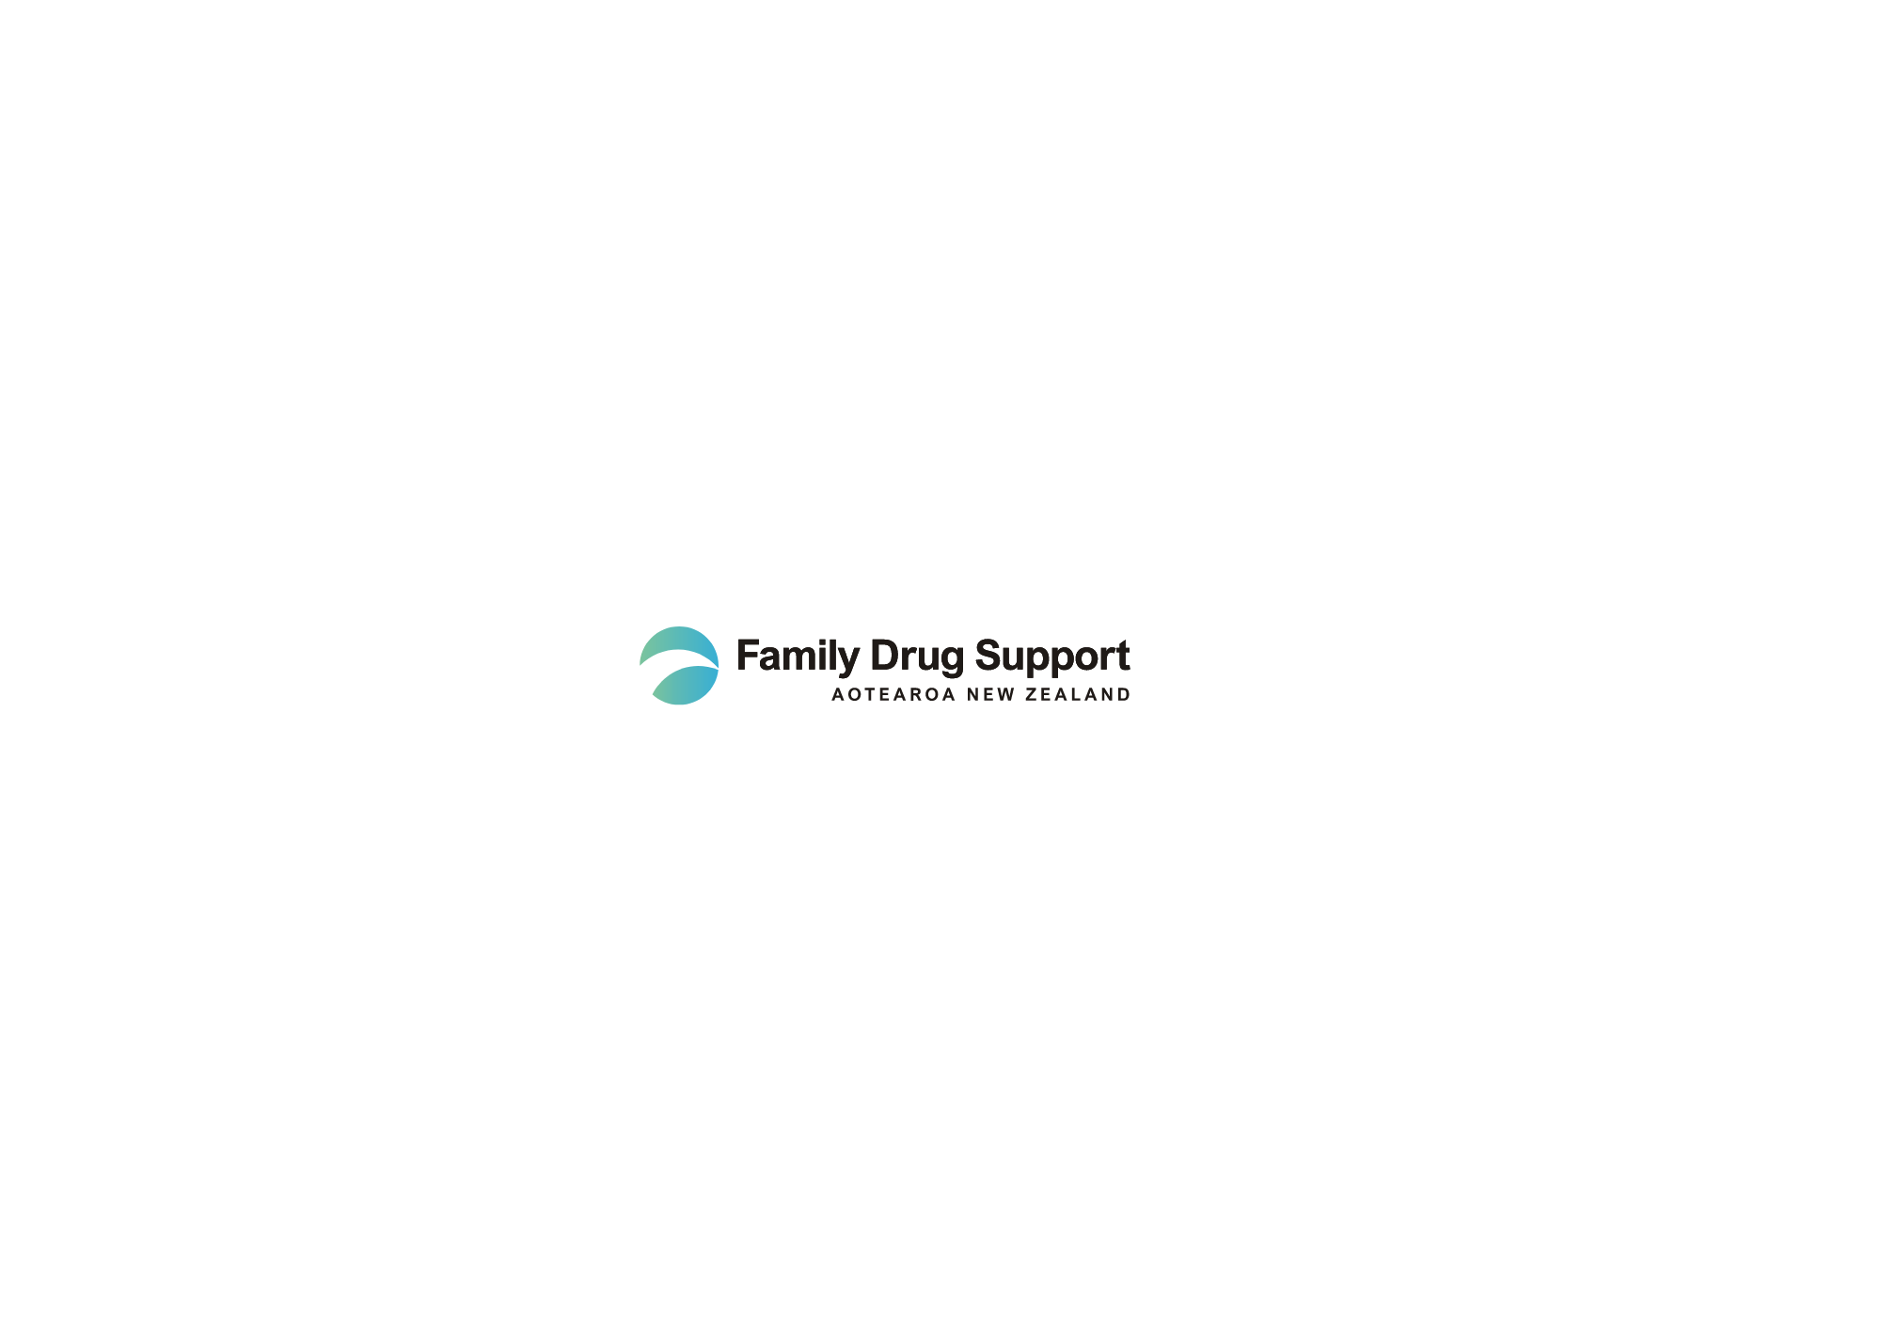
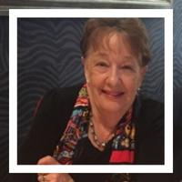
Outcomes of the 5-Step Method in a New Zealand Not-For-Profit Organisation
The Value of Data to Inform Practice
Dr Pauline Stewart
B.Ed., M.Ed., PhD., M.Ed (Counselling)
Registered Counselling Psychologist and Educational Psychologist
Executive Officer / Founder
Family Drug Support AotearoA New Zealand

Slide 2
Key requirements for any programme offered to Impacted Family Members
Culturally appropriate
Accessible no matter where one lives in New Zealand
Evidence-based with evaluation throughout

Slide 3
Omnibus Survey
February 2020
1,001 respondents aged 18-65+ in New Zealand
Over 41% impacted by the alcohol use of a family member or close friend.
Over 29% impacted by the other drug use of a family member or close friend.

Slide 4
University Research 8 Universities in New Zealand: Published in 2022, 946 respondents
Alcohol 36.2% Impacted
Other Drugs 37.5% Impacted
Type of other drug use reported
Cannabis reported by 36%
Ecstasy (MDMA) reported by 29%
Prescription Medication reported by 12%
Methamphetamine reported by 7%

Slide 5
What Can Data Tell Us?
Data tells us about…
The success of the 5-Step programmes we provide for Impacted Family Members
The parts of the programme we need to do additional professional development on
How well our Accredited Practitioners are serving the Impacted Family Members they work with
The reduction in family burden that has been achieved
The retention of Impacted Family Members over 5-6 psycho-educational counselling session
And many other aspects of our service delivery to Impacted Family Members

Slide 6
Data Collection
Family Member Questionnaire – Step 1
Family Member Questionnaire – Step 5
5 Step Demographic Data
Online Evaluation Survey at completion of 5-Step Programme
Online Evaluation Survey 3 months after 5-Step Completion

Slide 7
Demographic Data Completed 5-Step Programmes
Average Age of Impacted Family Member 52 years
Average of Focal Person 32 years
Length of use before IFM seeks current help 10 years
Gender of Impacted Family Member Female 79% Male 21%
Gender of Focal Person Male 66% Female 34%

Slide 8
Relationship of IFM to Focal Person
Mother (incl. Step Mother)
48%
Daughter (incl. Step Daughter)
18%
Husband (Male Partner)
13%
Brother (Incl. Step Brother)
9%

Slide 9
Primary Substance Involved
Alcohol 34%
Stimulants 23%
Cannabis 21%
Polydrug use (incl. alcohol + other drugs) 17%

Slide 10
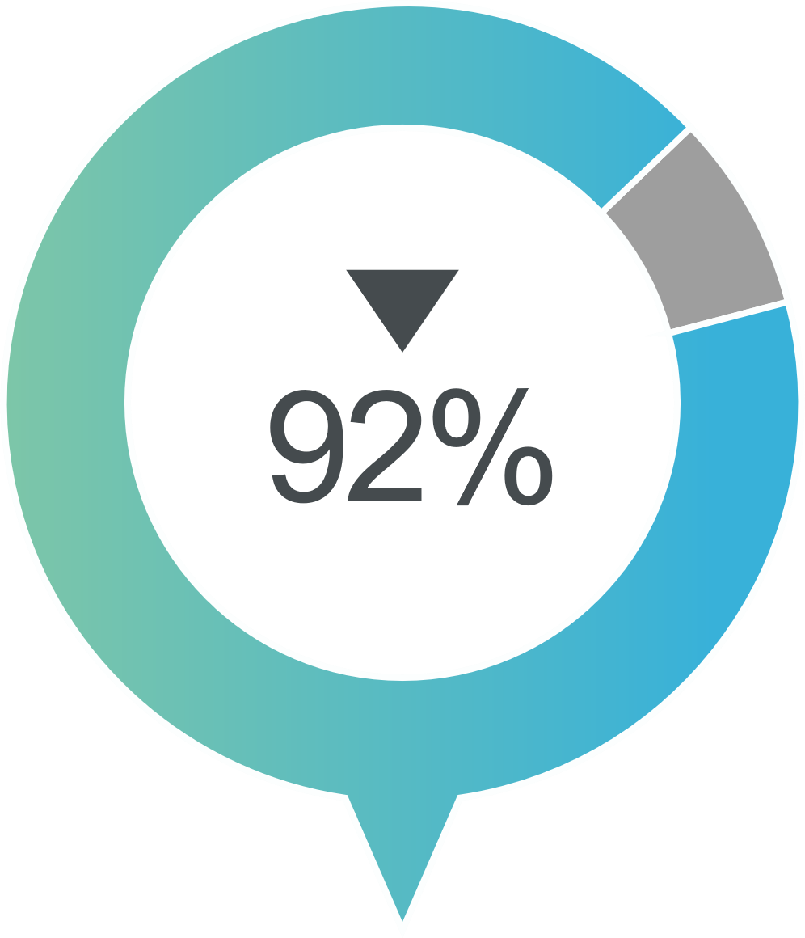
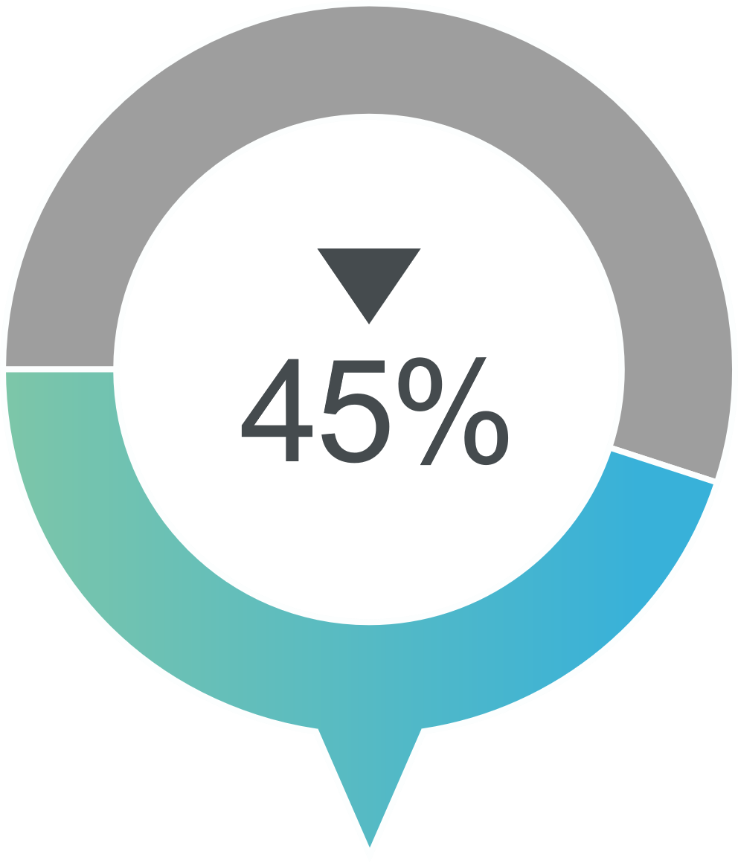
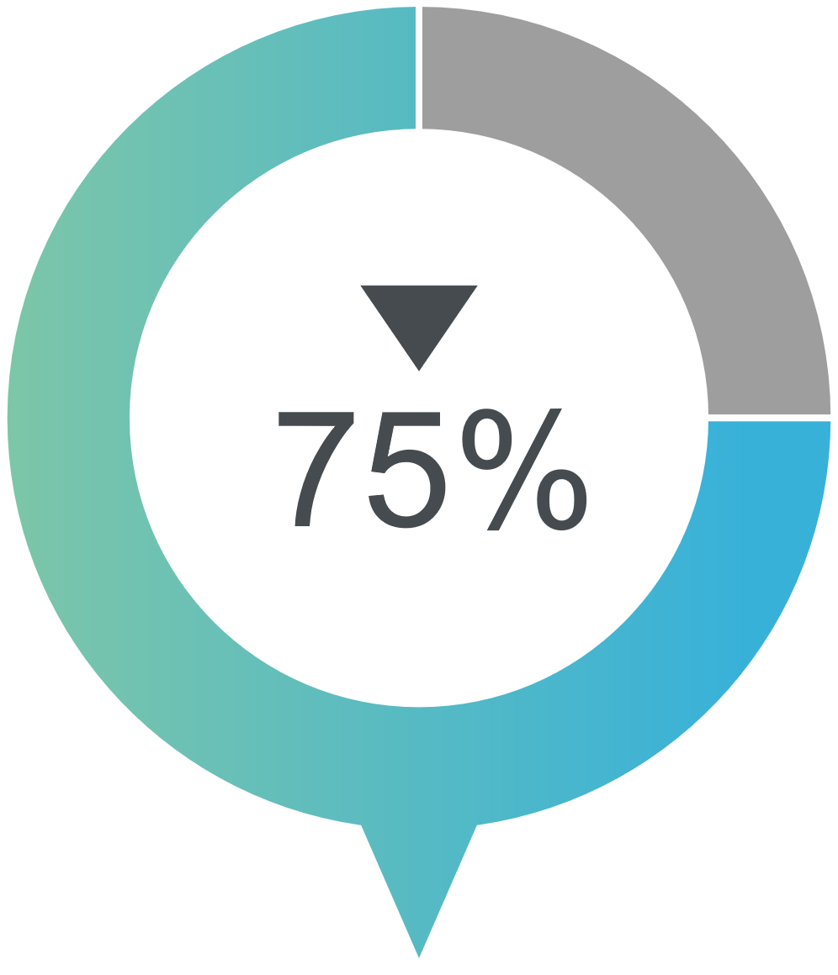
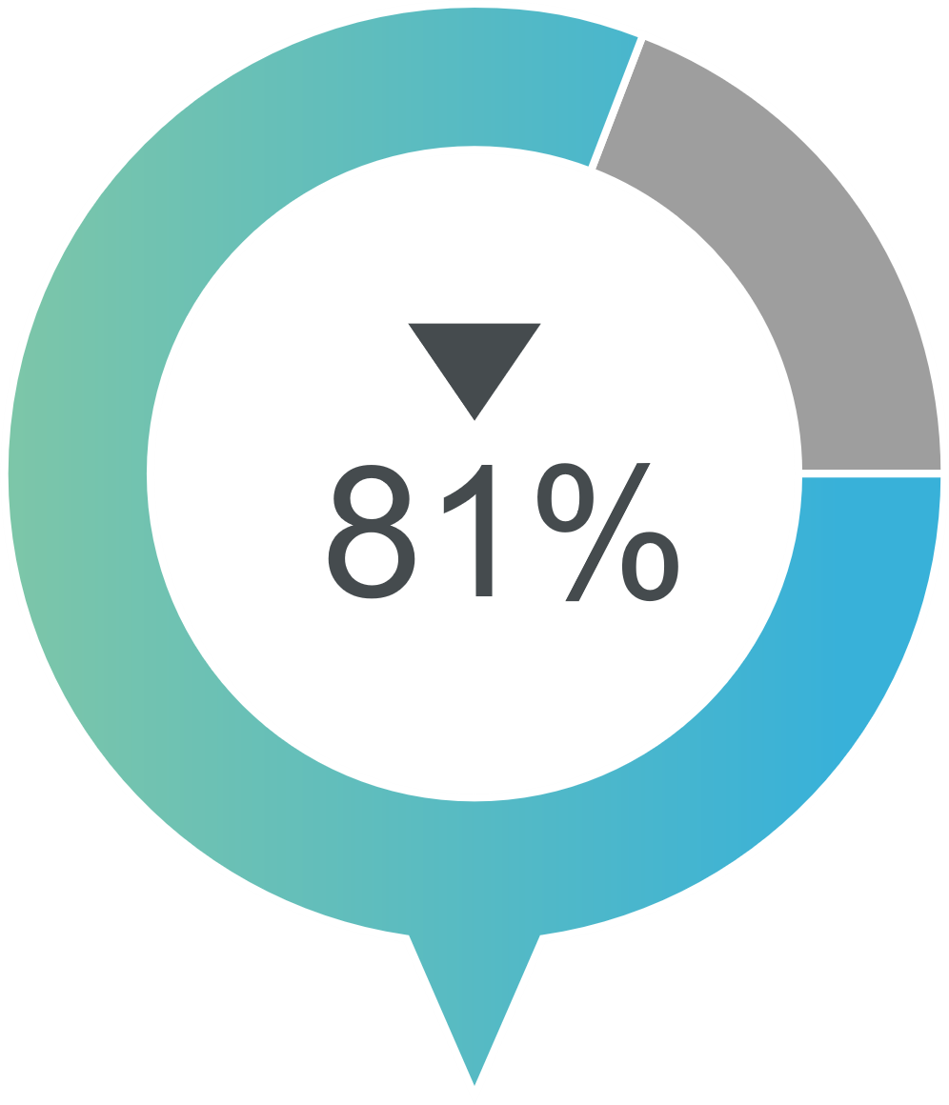
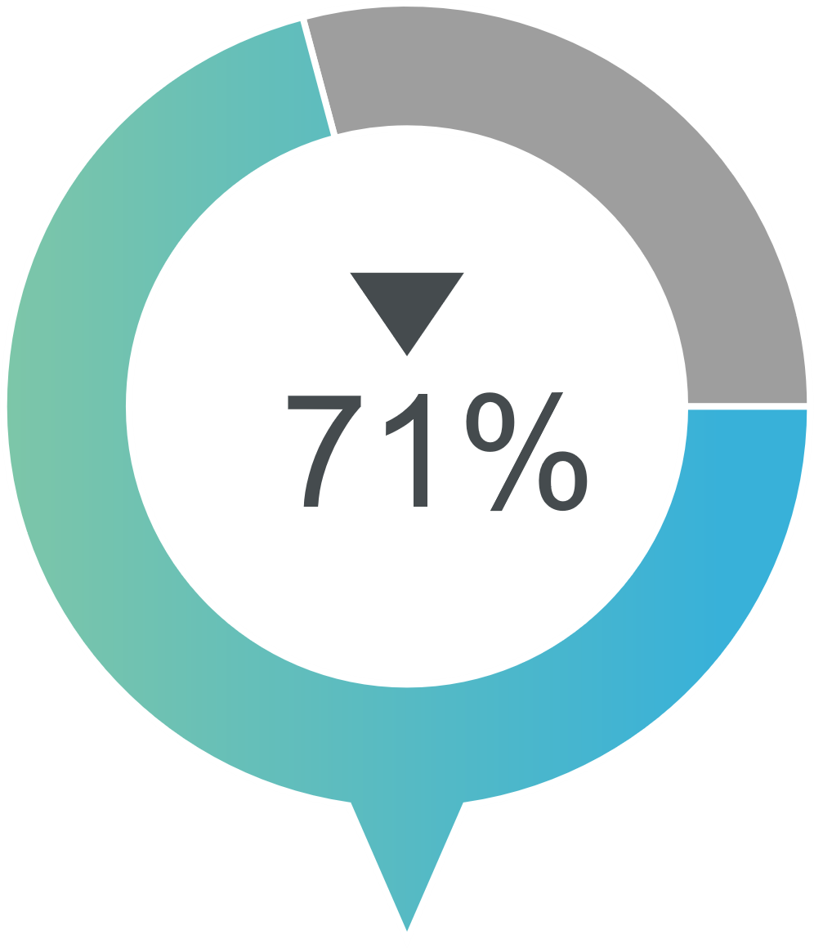
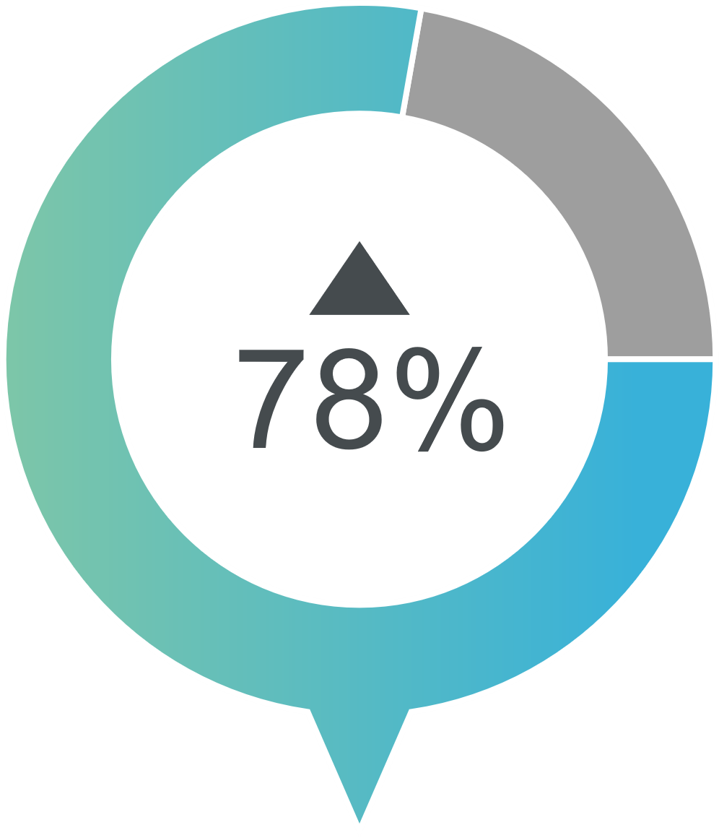
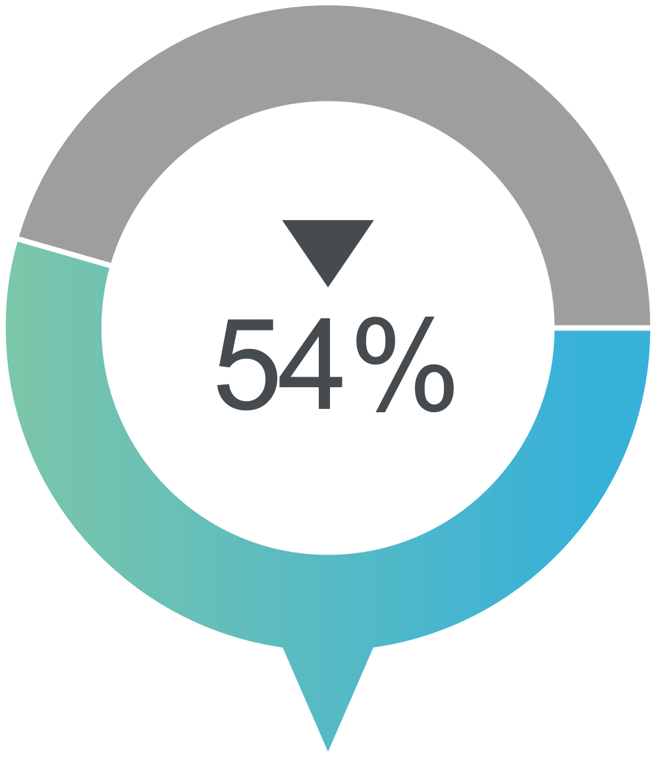
Impact On Total Family Burden
Stress Reported reduced experiences of stress including family finances, arguments and social life
Strain Reported reduced physical symptoms including; worry, irritability, poor concentration, sleeping problems
Coping Response Reported fewer emotional interactions with their substance using relative
Helpful Support Reported increase in helpful formal support
Unhelpful Support Reported reduced unhelpful support from family and friends

Slide 11
Over The Past Year…
123 enrolments (and increasing substantially)
91% of individuals starting the programme complete the full 5 sessions
29.5% of those completing the programme were couples
70.5% of those completing were individual Impacted Family members
Just 8.1% of those starting the 5-Step did not complete the programme
Another 59 currently working through the 5-Step

Slide 12
5-Step Benefits as Reported by Impacted Family Members post-5-Step Method Programme
On Likert Scale of 1-5
Impacted Family Members Agreed or Strongly Agreed
The Resource Pack Readings were helpful 100%
The 5 sessions of the programme met their needs 100%
They understand the importance of taking care of oneself 100%
They had an understanding of the ways to cope now 97%
They felt more able to face the future now 84%
They know when and how to access support now 90%
They would recommend the programme to friends 100%

Slide 13
Qualitative Data 5-Step Evaluation Online Survey
What did you like about the programme?
“The validation that (what) we are doing is good, there is no right way, there is still hope, chronic grief is a real thing, what we feel is normal, we are not alone, the emotional support offered.”
“Professional, highly knowledgeable, non judgmental, informative, easy to relate to counsellor, genuine, can do from home (accessible).”
“I particularly valued the way in which the programme assisted me to step back from the ongoing crises and objectively consider the family situation including the differing ways in which we were responding, that there was no wrong way of responding, practical exercises to think of new ways of supporting and responding.”

Slide 14
Feedback about the 5-Step Accredited Practitioner
“Absolutely amazing. If I could talk to her every day, I'd be such a happy woman!”
“LOVE YOUR WORK. I wish you had been around 15 years ago then all of this started to overwhelm me.”
“M was magnificent. She was empathetic, reassuring, and informative, and I felt better after each time we talked.”
“S was a perfect fit for us, relaxed, knowledgeable and professional, giving us opportunity to reflect on our own behaviours within an effective framework”

Slide 15
3-Month Follow-Up Online Survey 71% Response Rate
On Likert Scale of 1 Very Unhelpful to 5 Very Helpful, Impacted Family Members responded:
How helpful was it to be able to tell someone else about your situation and concerns?
How helpful do you consider the written and verbal information you received from FDS, and from your Accredited Practitioner, was?
How helpful do you consider the programme was in helping you to understand how to cope (engaging/tolerating/withdrawing) with the journey of your relative/loved ones' alcohol and/or other drug use?
4.7
4.7
4.5

Slide 16
How helpful did you find the session you completed on support for 4.2 yourself, with the support diagram?
In the last session, how helpful was it to review the changes you made 4.4
and think about your actions?
How helpful did you find the 5-Step programme in stressing the 4.7
importance of looking after yourself as you continue your journey?

Slide 17
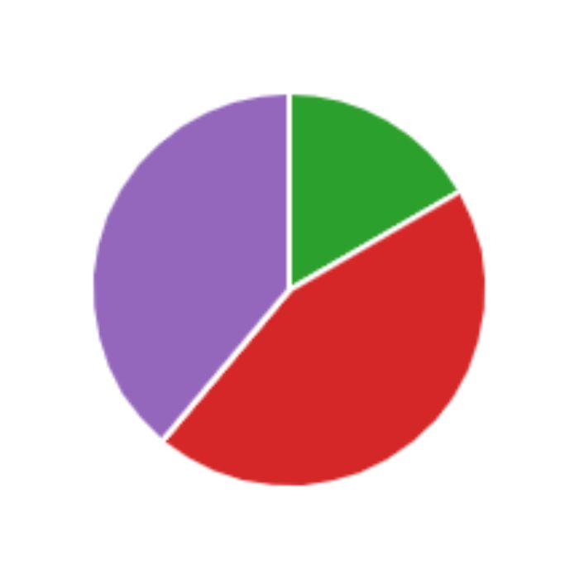
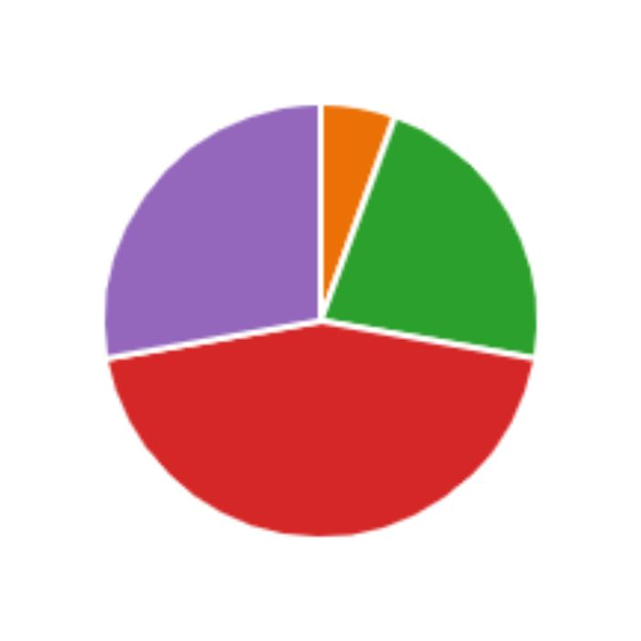
3-Month Post 5-Step Online Evaluation Survey
85% Able or More Able to Cope
3 months after 5-Step Programme
72% Better or Much Better Wellbeing
3 months after 5-Step Programme

Slide 18
Conclusions
Data matters in the development of services for Impacted Family Members.
Data…
is essential for the development of an evidence-based service
allows improvements needed to be identified and addressed
encourages funders to provide financial support and
gives confidence in the decisions made about programmes and interventions

Slide 19
Outcomes of the 5-Step Method in a New Zealand Not-For-Profit Organisation
The Value of Data to Inform Practice
Nga mihi nui. Thank you very much.
Dr Pauline Stewart
paulinestewart@fds.org.nz
www.fds.org.nz

Slide 20
Questions
Nga mihi nui Thank You Very Much
Dr Pauline Stewart
paulinestewart@fds.org.nz
www.fds.org.nz

